Slide 1
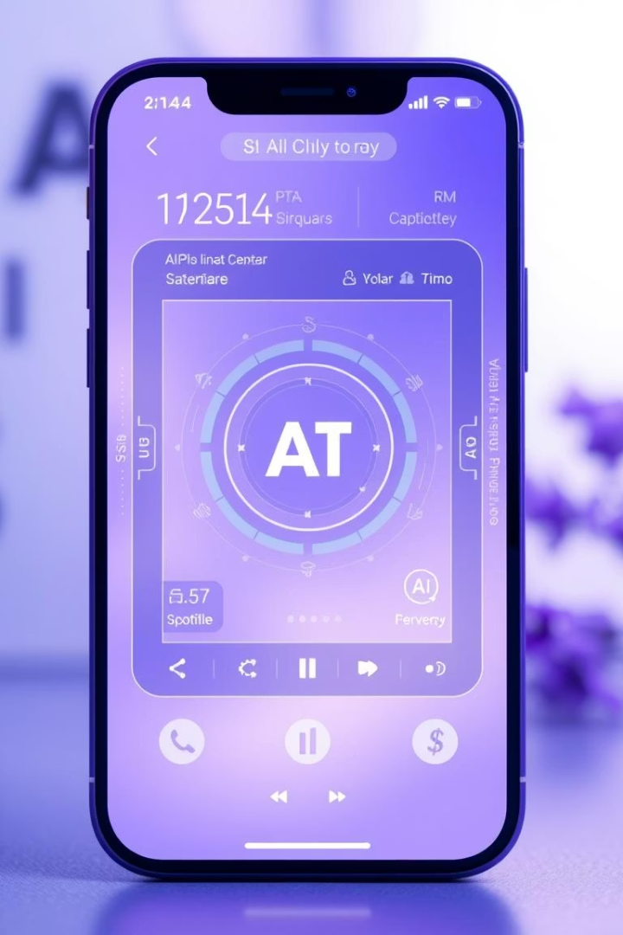

Gemini 2.5 Pro and Apple Partnership
Exploring the integration of Google's advanced AI model Gemini 2.5 Pro into Apple devices.
by Adza Rajasekhar

Slide 2

Gemini 2.5 Pro: Advanced AI Capabilities
Advanced Reasoning
Excels in complex problem-solving, surpassing top AI benchmarks.
Coding Performance
Leads in coding tasks with a 63.8% score on SWE-Bench Verified.
Multimodal Inputs
Handles text, images, audio, and video seamlessly.
Large Context Window
Processes up to 1 million tokens, with plans for 2 million.

Slide 3
Apple's AI Partnership Goals
Cutting-Edge AI Access
Enhance Device Features
Competitive Edge
Leverage advanced AI without full in-house development.
Improve Siri and other AI functionalities.
Stay ahead against rivals integrating AI tools.
Regulatory Compliance
New Revenue Streams
Partner with local firms to navigate market regulations.
Potential subscriptions and licensing deals.

Slide 4
Benefits of Gemini Integration for Apple
Enhanced Siri
Advanced AI Features
Developer Tools
Improved User Experience
Handles complex queries with advanced reasoning.
Improved coding assistance attracts developers.
AI-powered image editing and smart notifications.
Seamless multimodal and context-aware interactions.
Privacy & Security
Integration aligns with Apple’s privacy standards.

Slide 5

Partnership Status and Outlook
1
Negotiations Ongoing
Deal hoped by mid-2025, with Gemini AI integration planned.
2
Beta Code Evidence
iOS 18.4 beta shows Google AI options alongside OpenAI.
3
Expected Launch
Integration may debut in iOS 19 or later in 2025.
4
Strategic Importance
Apple diversifies AI partnerships to boost competitiveness.

